Slide 1
Customer Churn Prediction in Telecom using Machine Learning
DISSERTATION

Slide 2
Submitted in partial fulfillment of the requirements of MTech Software Engineering Degree Programme
By
Samarth Malhotra
2018ap04535
Under the supervision of
Mayank Jain
Principal Software Developer

Slide 3
Abstract
Customer churn is the likelihood of a customer to leave a brand, stop using its services and switching over to other providers. It is a major challenge in businesses with subscription-based model and has direct impact on the revenue of the company, especially in the telecom field. The cost of churn includes both the loss of revenue and the marketing costs involved in replacing those customers with new ones, therefore, predicting and preventing customer churn has a potential revenue source therefore the telecom companies must make an effort to retain their customers.
Customer churn prediction modelling aims to understand the customer’s behavior and attributes (gender, age, dependents, financial status), also the likelihood to switching of the brand, possible reasons and the remedial measures to retain the customer.
With a better understanding and an insight into potential customers leaving the brand in the volatile market condition, the brand can take a suitable action after the analysis which will lead to most retention impact on the customer.

Slide 4
Objective
Create visualizations to showcase how each feature is affecting the target class
Create multiple machine learning models to predict the target variable and evaluate them with multiple metrics (AUC Score, precision, recall, f1 score)
Identify the features which are important for the chosen model

Slide 5
Benefit to the organization
Oracle provides end to end cloud solutions to telecommunication providers, it spans everything from capturing the network calling data to billing and processing payments to generating audit reports.
The project will directly benefit Oracle in providing up to date information about customer churn to its client i.e., telecom operators and operators in turn will ensure that the customer churn could be prevented in time by opting for retention strategies which will have direct impact on their revenue.

Slide 6
Data Acquision
Here we are using sample dataset provided by IBM community, the dataset contains information about a fictional telco company that provided home phone and internet services to 7043 customers in California in Q3. It indicates which customers have left, stayed, or signed up for their service. Multiple important demographics are included for each customer, as well as Customer Lifetime Value (CLTV) index.

Slide 7
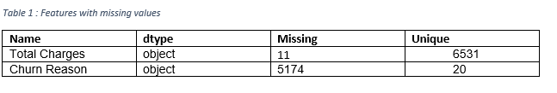
Data Preprocessing
Handling Missing Data
The dataset has some missing values for features Total Charges and Churn Reason, for records where Tenure Months is 0 there is no value for Total Charges, also for feature Churn Reason for all the data points where Churn Label is No. i.e. The customers who have not left the company there will be no Churn Reason. Before imputing any value for Total Charges, we are changing the data type of the feature from object to float.

Slide 8
We can impute the values for Churn Reason for the missing values as Not Available as the churn didn’t happen also upon closer observation, we can observe that there is a strong correlation between the numerical features Tenure Months, Monthly Charges and Total Charges. If we calculate correlation coefficient for (Tenure Months x Monthly Charges) and Total Charges it is 0.9995605537972277 and therefore we can impute the missing values of the feature Total Charges with (Tenure Months x Monthly Charges).
Removing Unnecessary Features
We are removing unnecessary features such as latitude longitude, zip code, country, state and churn score as the data is only for United States of America also its for state of California, we have removed latitude, longitude and information as we will be using City to identify the location. We are removing the churn score as its not part of actual data but generated by IBM SPSS tool.

Slide 9
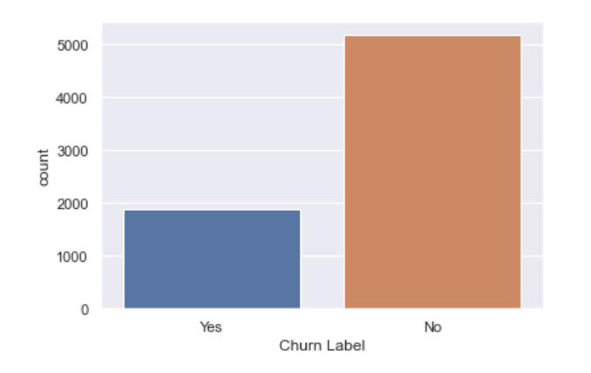
Data Exploration
We are firstly performing Univariate Analysis
Churn Label is the target feature and as we can observe from above plot the dataset is unbalanced, there are more data points for customers who have not churned while performing model creation and any analysis we have to keep this in mind.

Slide 10
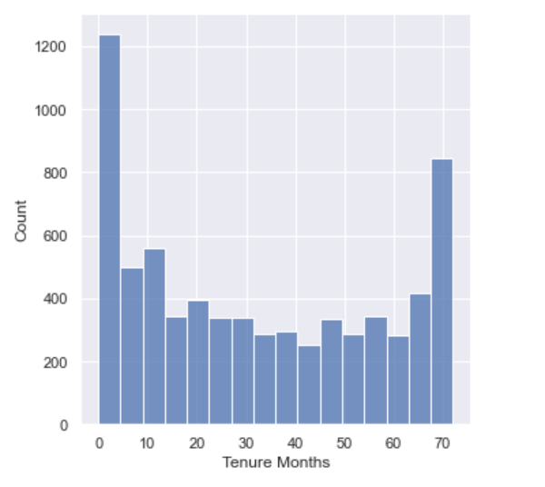
From the above numerical feature Tenue Months, we can observe that it is a bimodal distribution, which means there are two different kinds among customers and we can find out what services are kept by those who stay more than 70 months.

Slide 11
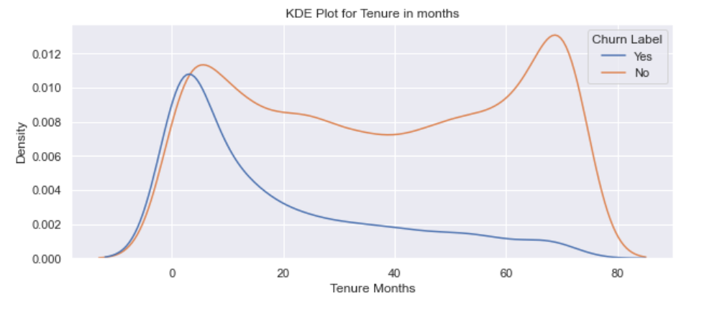
Secondly, we will perform bivariate analysis of numerical features, we will see how different numerical features are distributed in terms of target variable.
From above kernel density estimation plot we can see the probability density function of numerical feature Tenure Months; it can be observed that customers who have recently joined are more likely to churn.

Slide 12
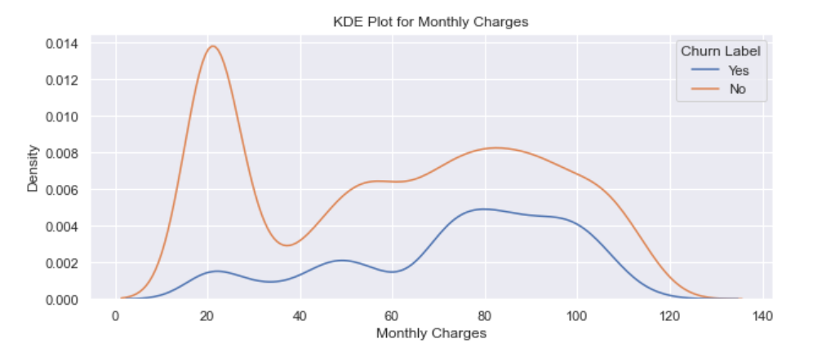
From above kernel density estimation of numerical feature Monthly charges, we can observe that customers with higher monthly charges are more likely to churn than those with lower monthly charges.

Slide 13
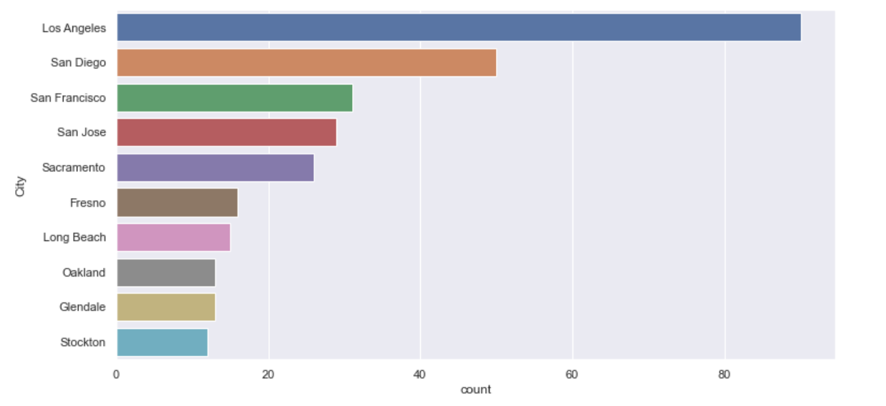
From the above plot it is easily visible that city Los Angeles, San Diego, San Francisco, San Jose, Sacramento accounts for most churn customers and therefore we need to investigate further why so many customers are leaving from these particular locations.

Slide 14
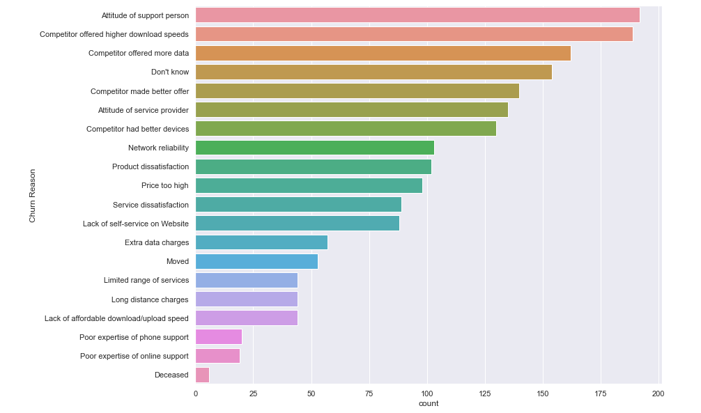
From the above distribution plot of Churn Reason, it can be observed that the reason of highest churn among customers is dissatisfaction from support services and internet data and speed and therefore remedial actions can be taken to improve support service and internet speed also we can come up with better internet plans.

Slide 15
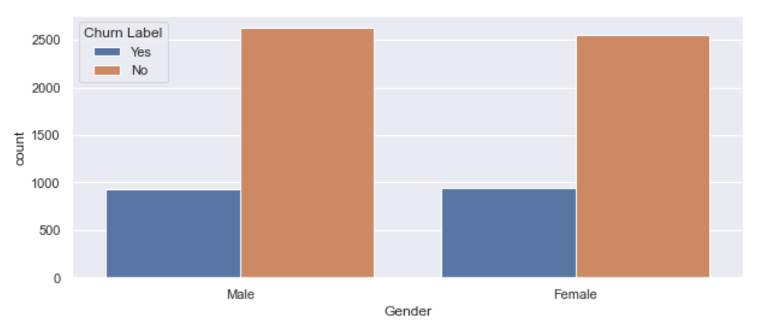
From the above figure we can see that feature gender has no influence on customer churn

Slide 16
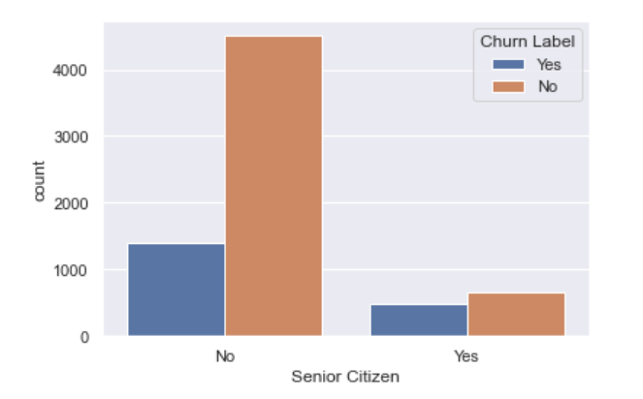
From the above distribution plot, we can observe that, even though there are only 16 % senior citizen among total customers but the churn rate among senior citizens in 41.6 % compared to 23.6 % in younger customers.

Slide 17
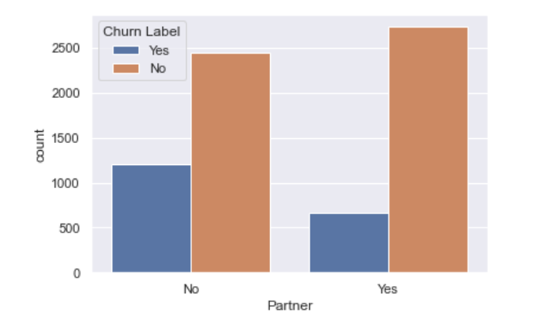
From above distribution plot it is evident that customer without partners is more likely to churn in comparison to customers with partners.

Slide 18
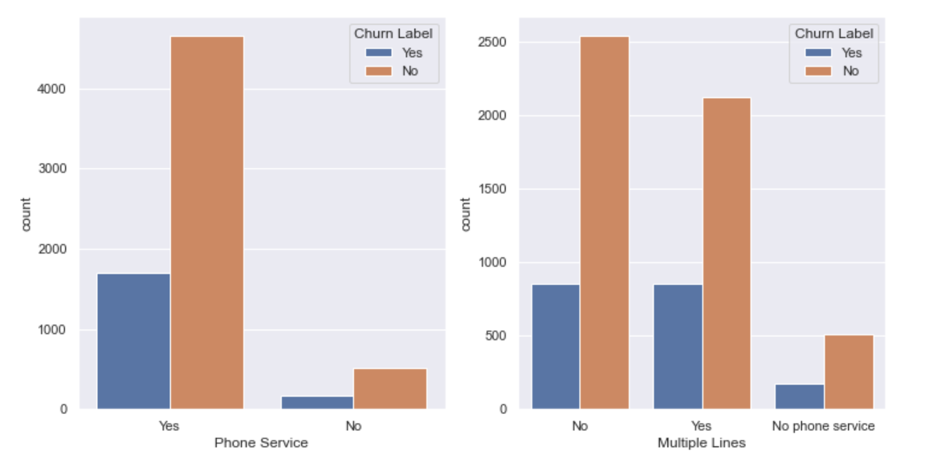
From the above distribution plots, it is evident that customer with no phone service is less and customers with multiple lines have slightly higher churn.

Slide 19
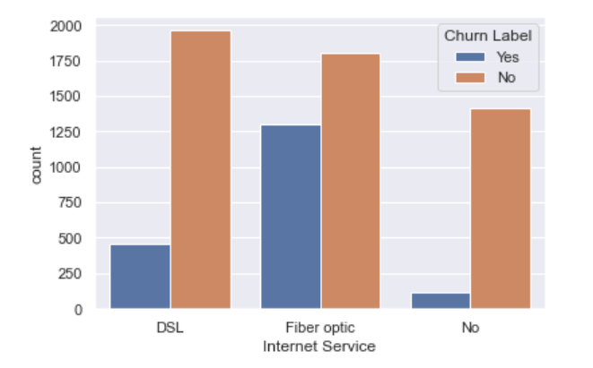
It can be observed from above plot that customers without internet have very low churn, also customers with fiber optic cable are more likely to churn than customers with DSL connection.

Slide 20
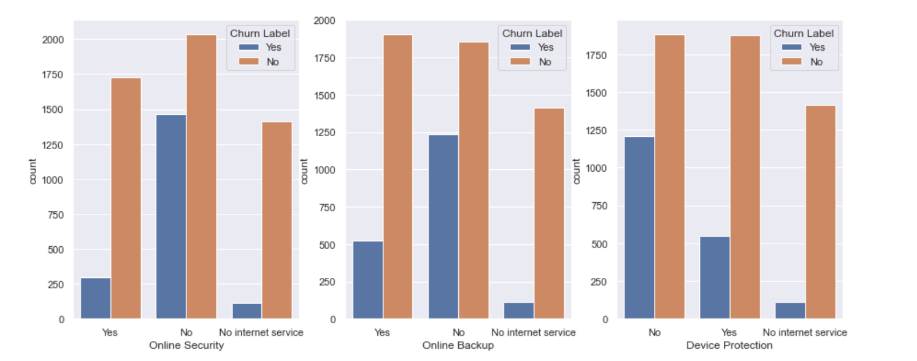
From above plot it is evident that
customers without internet are less likely to churn
Customer with online security is less likely to churn
Customers with online backup are less likely to churn
Also, customers with device protection are less likely to churn

Slide 21
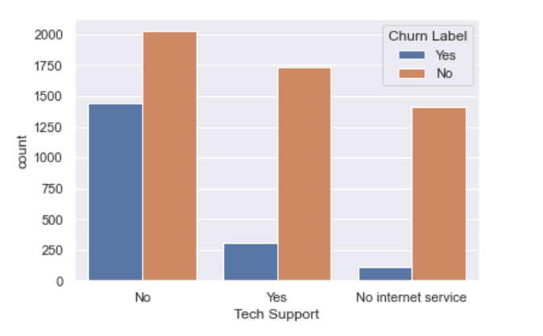
From the above plot we can see that customers with tech support are less likely to churn

Slide 22
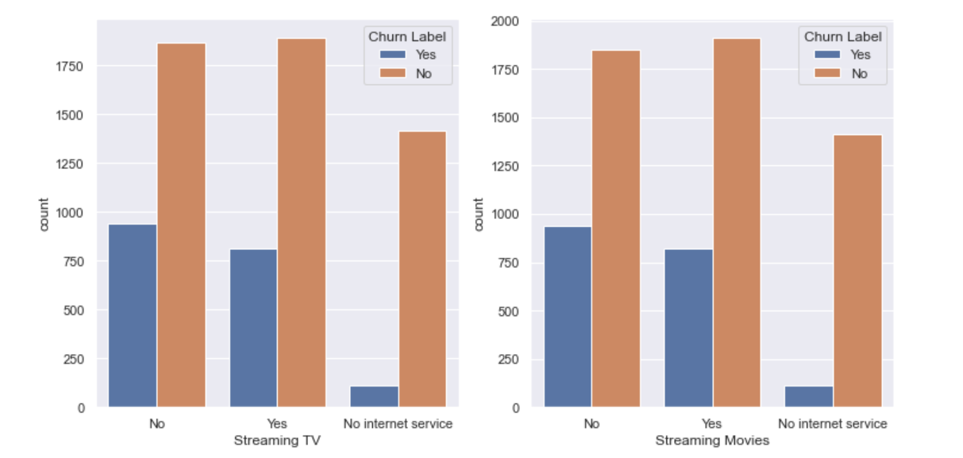
From above plot it is very evident that customers with Streaming TV and Streaming Movies are less likely to churn.

Slide 23
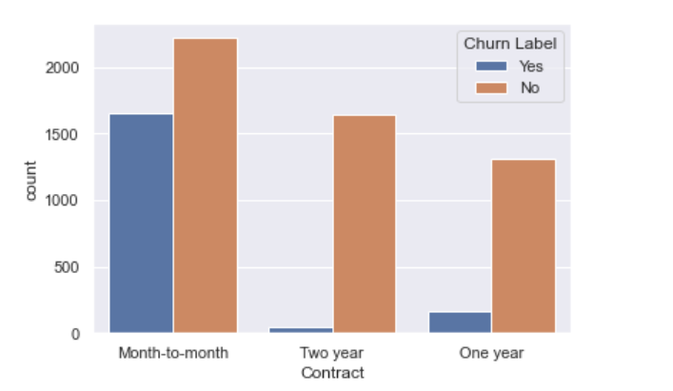
From the above graph we can observe that customers one-year and two-year contracts are less likely to churn.

Slide 24
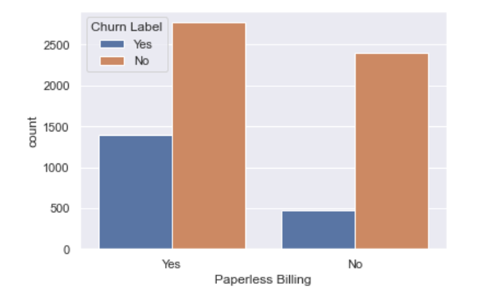
From above plot we can observe that customers with paperless billing are more likely to churn as compared to other customers.

Slide 25
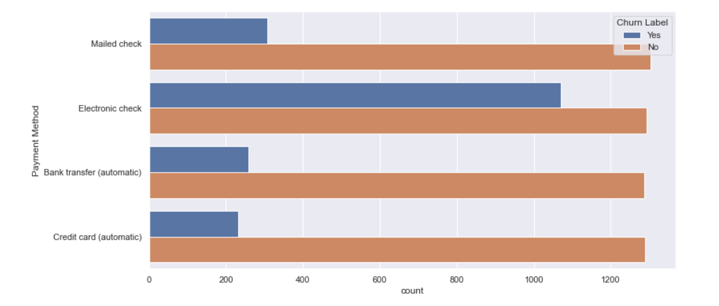
From the above plot we can observe that customers with electronic check are more likely to churn compared to other payment methods.

Slide 26
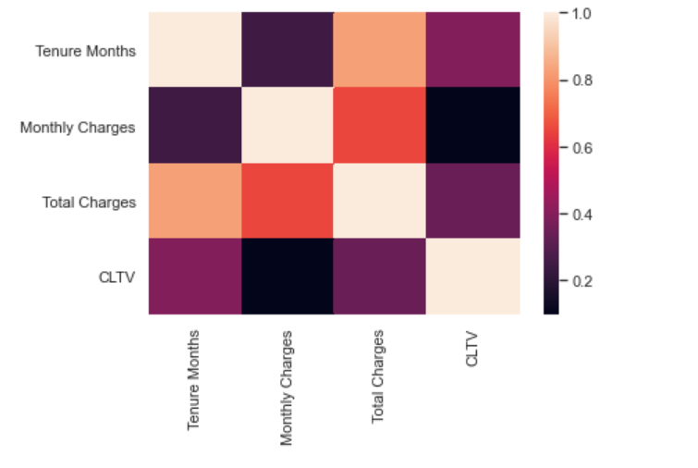
From the above heatmap it is very clear that Tenure Months and Total charges are highly correlated, similarly for categorical features we have created a separate dataset and created correlation matrix.

Slide 27
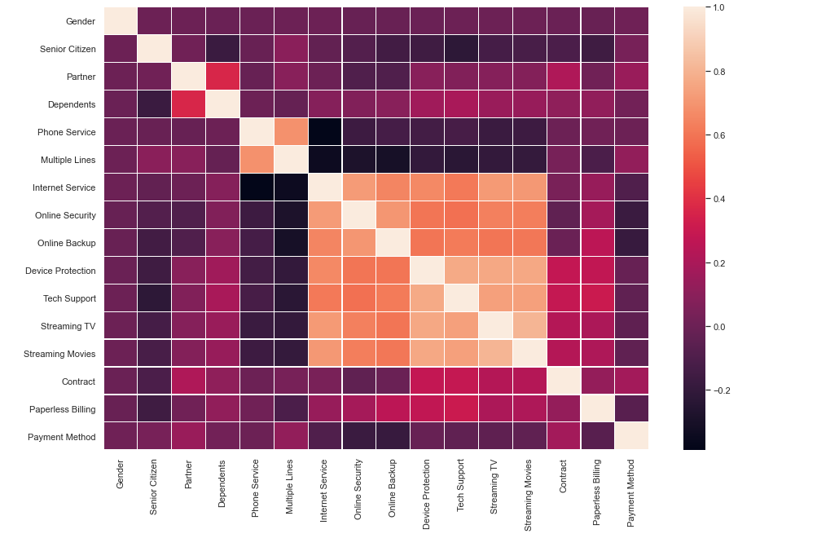
Form the above heatmap we can observe that Phone Service and Multiple Lines are correlated, similarly, internet Service, Online Security, Device Protection, Tech Support, Streaming TV and Streaming Movies are correlated.

Slide 28
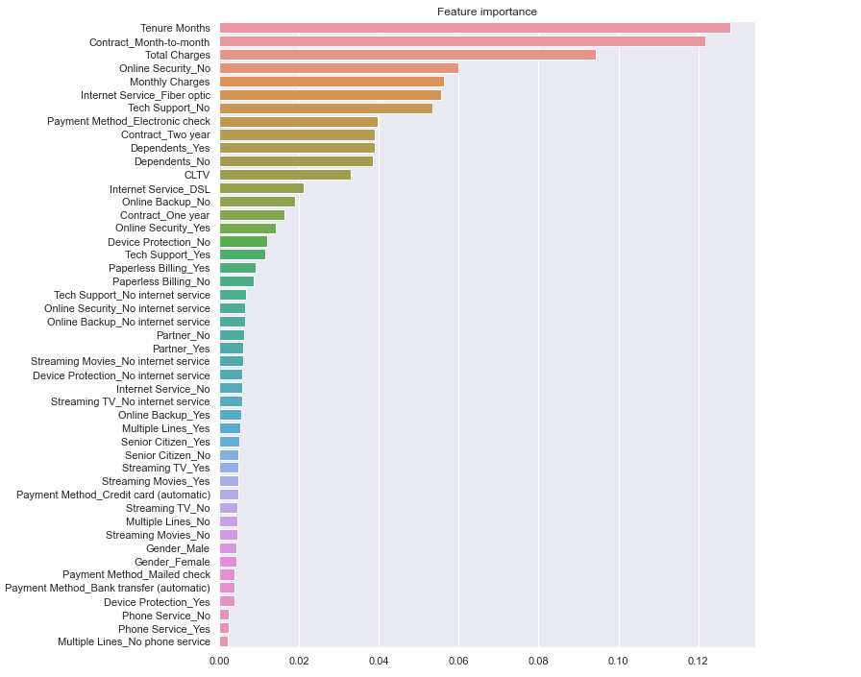
As we have also observed in exploratory data analysis numerical features Tenure Months, Monthly Charges, and Total Charges are very important features to predict customer churn also categorical features Contract Mouth-to-mouth which are highly likely to churn. These results obtained are in line with the results obtained in exploratory data analysis.

Slide 29
Model Creation and Evaluation
For this project we have created multiple machine learning model and also performed comparative study.
Logistic Regression
We started with the most commonly used model for classification i.e., Logistic Regression, Logistic function comes from Sigmoid family of functions and assign probability for the class for the given set of inputs. The Logistic Regress ion is a discriminative classifier means it learns the boundaries between the classes. It makes predictions based on conditional probability. The learning algorithm works as we train the model across the data points and adjust the parameters using the training labelled data and then again test the model using a separately held out data called the test data.
Before training the model, we scaled (standardized) the features of the dataset using min max scaler, it helps normalize the data within a particular range it also helps in speeding up the calculations.
The train-test data is split in 70 - 30 proportion and then the model is trained with training data. As the distribution of target feature is un-balanced, we have used class_weight=’balanced’ (It penalizes mistakes in sample of class[i] with class_weight[i] instead of 1. So higher class-weight means we want to put more emphasis on a class which is less in proportion.

Slide 30
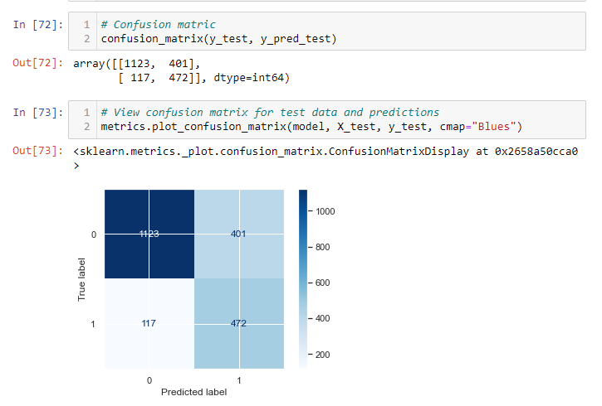
We get an accuracy score of ~ 0.755, Here accuracy score is not a good measure as the dataset is imbalanced means that there are more records which are not customer churn and therefore model is trained more to classify customer which did not churn.

Slide 31
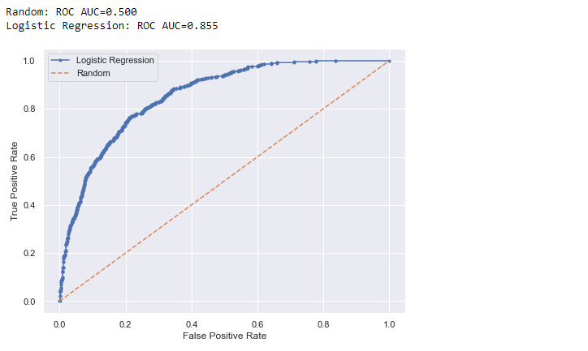
Therefore, finding confusion matrix which is a way to express how many of a classifier's predictions were correct, and when incorrect, where the classifier got confused. here the rows represent the true labels and columns represents the predicted labels. values on the diagonal represent the number of times where the predicted label matches.
Also, the classification report is shown below:
The classification report provides various metrices to evaluate the classifier, like precision, recall, F1 Score etc.
Similarly, we have also computed ROC – AUC ~ 0.855
 | precision | recall | f1-score | support
0 | 0.91 | 0.74 | 0.81 | 1524
1 | 0.54 | 0.80 | 0.65 | 589
accuracy |  |  | 0.75 | 2113
macro avg | 0.72 | 0.77 | 0.73 | 2113
weighted avg | 0.80 | 0.75 | 0.77 | 2113

Slide 32
Here the function takes both the true outcomes (0,1) from the test set and the predicted probabilities for the 1 class. The function returns the false positive rates for each threshold, true positive rates for each threshold and thresholds.
Naive Bayes
Naïve Bayes classifiers in machine learning are a family of probabilistic classifiers based on applying Bayes Theorem with strong (naive) independence assumptions between the features. They are among the simplest Bayesian network models and with KDE they can achieve very good accuracy scores.
These are generative classifiers i.e.; it tries to model class or features of class means it models how a particular class would generate input data. When a new observation is given to these classifiers, it tries to predict which class would have most likely generated the given observation.
As with Logistic regression classifier before we have trained the classifier, we are normalizing the data and splitting it into train test and then fitting the model, for this project we have used Gaussian Naïve Bayes Classifier as it was providing better scores. The accuracy score we have received from this classifier is ~ 0.72. Also, the confusion matrix, classification report and the ROC-AUC is mention below.

Slide 33
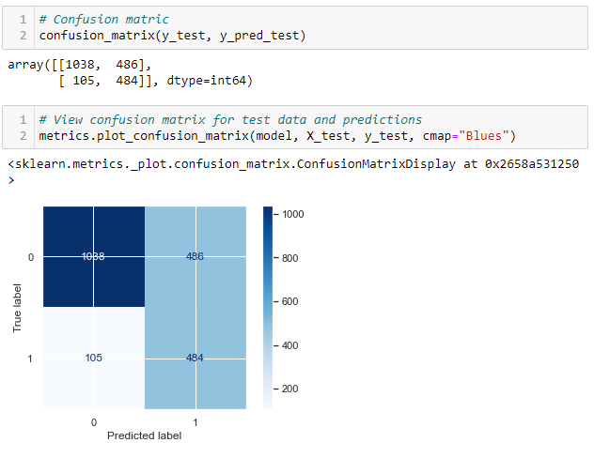
 | precision | recall | f1-score | support
0 | 0.91 | 0.68 | 0.78 | 1524
1 | 0.50 | 0.82 | 0.62 | 589
accuracy |  |  | 0.72 | 2113
macro avg | 0.70 | 0.75 | 0.70 | 2113
weighted avg | 0.79 | 0.72 | 0.73 | 2113

Slide 34
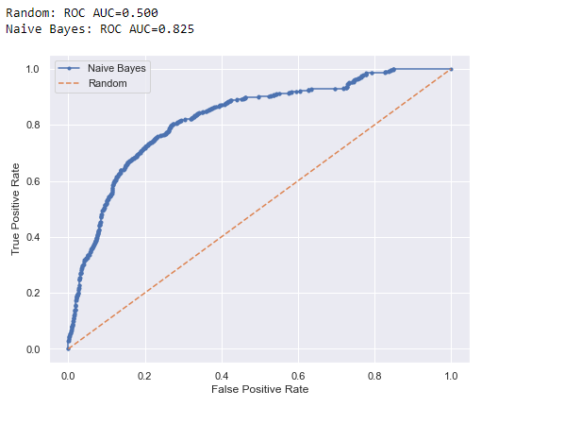
We have also included some ensemble methods which use bagging and boosting to see what performance we get for our dataset, to start with we used Random Forest Classifier.
Random Forest
Random Forest is an ensemble classifier which basically means it uses many base classifiers, here the base classifier mostly used is decision tree classifier. Random Forest uses bagging technique, it trains many classifiers in parallel, there is no interaction between these trees while building the trees. Once all the trees are built then voting or average is taken across all the trees.
Similar to previous methods before training random forest classifier we have normalized the data and split it into train and test. The model is trained on training data and is evaluated using a

Slide 35
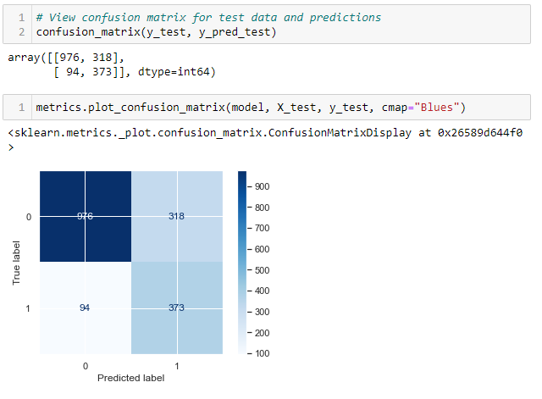
separately held out test data. Following are the performance metrics we are getting starting with accuracy score of ~ 0.766. Further metrics like precision, recall, F1 Score and ROC-AUC are shown below:
 | precision | recall | f1-score | support
0 | 0.91 | 0.75 | 0.83 | 1294
1 | 0.54 | 0.80 | 0.64 | 467
accuracy |  |  | 0.77 | 1761
macro avg | 0.73 | 0.78 | 0.73 | 1761
weighted avg | 0.81 | 0.77 | 0.78 | 1761

Slide 36
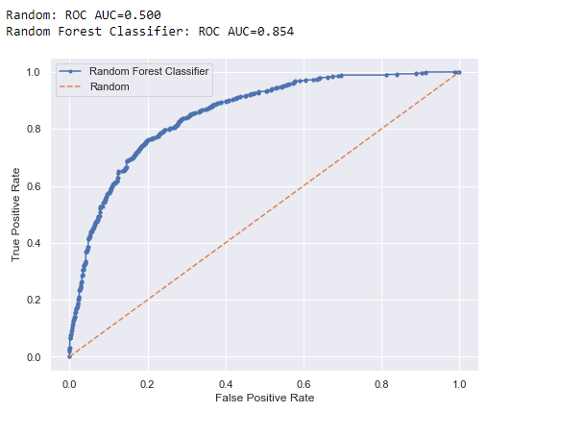
At last, we have also trained a boosting based ensemble method called Gradient Boosting Classifier.
Gradient Boosting
Gradient Boosting is an ensemble classifier which basically means it uses many base classifiers, here the base classifier mostly used is decision tree classifier. Gradient Boosting uses boosting technique, it trains many classifiers in sequence which means the output of one is input to the other, this is done by building a model from the training data, then creating a second model that attempts to correct the errors from the first model. The models are added until the training set is predicted perfectly or a maximum number of models are added.

Slide 37
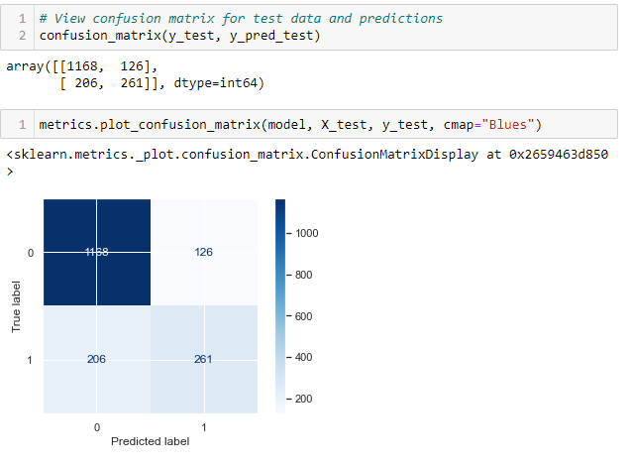
Similar to previous methods before training random forest classifier we have normalized the data and split it into train and test. The model is trained on training data and is evaluated using a separately held out test data. Following are the performance metrics we are getting starting with accuracy score of ~ 0.81. Further metrics like precision, recall, F1 Score and ROC-AUC are shown below:
Similarly, Classification report for Gradient Boosting classifier is shown below

Slide 38
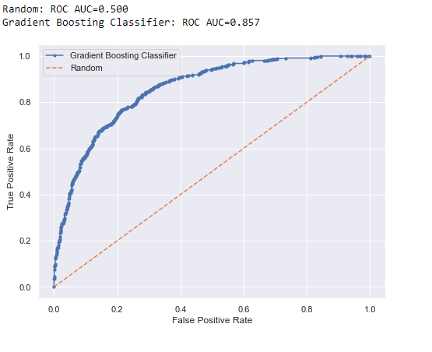
 | precision | recall | f1-score | support
0 | 0.85 | 0.90 | 0.88 | 1294
1 | 0.67 | 0.56 | 0.61 | 467
accuracy |  |  | 0.81 | 1761
macro avg | 0.76 | 0.73 | 0.74 | 1761
weighted avg | 0.80 | 0.81 | 0.81 | 1761

Slide 39
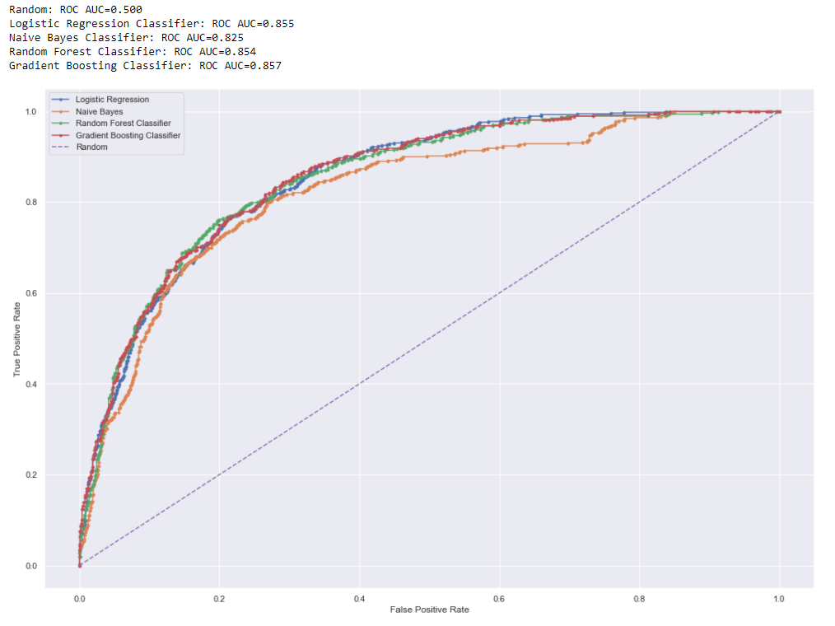
Comparing Models
Comparison of ROC-AUC for different classifiers

Slide 40
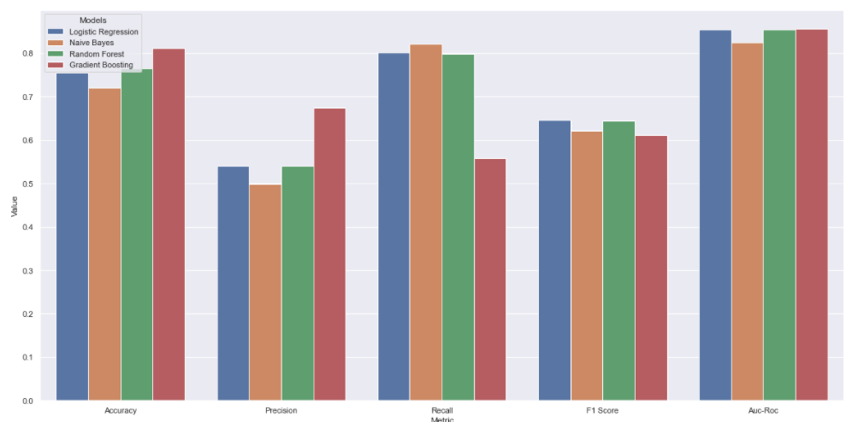
The above chart shows receiver operating characteristics for different classifiers, The ROC curve, is a graphical plot that illustrates the diagnostic ability of a binary classifier system as its discrimination threshold is varied. Similarly, Accuracy, Precision, Recall, F1 Score of different classifiers are shown in below table.
 | Models | Accuracy | Precision | Recall | F1 Score | Roc-Auc
1 | Logistic Regression | 0.754851 | 0.540664 | 0.80136 | 0.64569 | 0.85487
2 | Naive Bayes | 0.720303 | 0.498969 | 0.82173 | 0.62091 | 0.82484
3 | Random Forest | 0.766042 | 0.539797 | 0.79872 | 0.64421 | 0.85404
4 | Gradient Boosting | 0.811471 | 0.674419 | 0.55889 | 0.61124 | 0.85697

Slide 41
The precision and recall measures are also widely used in classification. Precision can be thought of as a measure of exactness (i.e., what percentage of tuples labeled as positive are actually such), whereas recall is a measure of completeness (what percentage of positive tuples are labeled as such). If recall seems familiar, that’s because it is the same as sensitivity (or the true positive rate). These measures can be computed as precision = TP / (TP + FP) recall = TP / (TP + FN) = TP / P.
A perfect precision score of 1.0 for a class C means that every tuple that the classifier labeled as belonging to class C does indeed belong to class C. However, it does not tell us anything about the number of class C tuples that the classifier mislabeled. A perfect recall score of 1.0 for C means that every item from class C was labeled as such, but it does not tell us how many other tuples were incorrectly labeled as belonging to class C. There tends to be an inverse relationship between precision and recall, where it is possible to increase one at the cost of reducing the other. From the above data we can see that even though the accuracy and ROC-AUC is higher for ensemble methods like Random Forest and Gradient Boosting Algorithm but the recall is highest in Logistic Regression and Naive Bayes Recall = TP/ (TP + FN) = TP/P, A perfect recall score of 1.0 for a class C means that every item from class C was labelled as such but it does not tell us how many other tuples were incorrectly labelled as belonging to class C i.e., it does not tell us about false positive. Here we can tolerate False positive but can't tolerate False Negative as it be loss to the revenue of the organization. Here we have taken an arbitrary cutoff recall score and ROC-AUC of 0.8 to select our models.
Therefore, from above data we can conclude that in our dataset the Logistic Regression and Naive Bayes classifier are providing good recall score and good roc-auc score.

Slide 42
Scope of work
Acquisition of data
Preprocessing of data
Exploration of data
Implementation of model to predict churn using python
Visualizations
Report creation
Resources needed for the project
Telecom customer data
Visualization libraries
Windows machine
Python libraries
Jupyter Notebook

Slide 43
Conclusion/Recommendation
We can now conclude the research work highlighting that for given dataset Logistic Regression Classifier and Naïve Bayes Classifier provide the overall best scores and also, they are much easier to interpret.
In this study we have created multiple models which are Logistic Regression, Naïve Bayes, Random Forest and Gradient Boosting and evaluated these models on multiple metrices like accuracy, precision, Recall, F1 Score and ROC-AUC (Receiver Operating curve).
We have also performed comparison of these models based on above metrices, here as the distribution of the target variable is imbalanced, the accuracy only tells us how good the model is on predicting customers which are not churning and therefore to shortlist we have instead used Recall and ROC-AUC.
In this research work we have created prediction models for customer churn in telecom sector, we can integrate these models with live customers data and give details above which customers are likely to churn to telecom vendors, with this information telecom vendors can use retention strategies.
The live details of the customer churn can be shown in the business dashboard with proper visualizations.

Slide 44
Directions for future work
In future we can improve the models with more data points and attributes also we use. We can design UI to visualize the churn data effectively.
Also, we can take feedback from telecom vendors and provide more details and analysis.

